Slide 1
CS 4235 FINAL REVIEW
2019-04-18

Slide 2
Intrusion Detection Intrusion Detection Systems (IDS)
Effective in already known, less sophisticated attacks, less effective in sophisticated targeted attacks, not effective in zero-day exploits.
Primary assumptions
Normal and intrusive activities have distinct evidence. Behavior of the intruder differs from that of a legitimate user in ways that can be quantified.
Deployment
Host-based
Network-based

Slide 3
Intrusion Detection Analysis Approaches
Anomaly Detection
Establish profile for legitimate user over time
Collect data relating to the behavior of legitimate users over a period of time. current observed behavior is analyzed to determine whether this behavior is that of a legitimate user or that of an intruder.
Misuse/Signature Detection
Use signature to record information that represents an attack
Uses a set of known malicious data patterns (signatures) and compare them with current behavior.
The signatures need to be large enough to minimize the false alarm rate, while still detecting a sufficiently large fraction of malicious data.
^_^: Low cost in time and resource in use, wide acceptance.
>_<: Can only identify known attacks for which it has identifiable patterns or rules. Unable to detect zero-day attacks.
>_<: Significant effort to identify and review new malware to create signatures.

Slide 4
Intrusion Detection Classification Approaches
Statistical
Using multivariate or time-series models of captured sensor data.
^_^: Relatively simple, low computational cost, lack of assumptions about expected behavior.
>_<: Difficult to select suitable metrics. Not all behaviors can be modeled in this way.
Knowledge Based
Uses an expert system that classifies observed behavior according to a set of rules that model legitimate behavior.
^_^: Robust and flexible.
>_<: The amount of time required to develop knowledge from the data.
>_<: Human expert must assist with the process.

Slide 5
Intrusion Detection Classification Approaches
Machine Learning
Classify data as normal or anomalous.
Clustering and outlier detection: Group the observed data into clusters then identify subsequent data as either belonging to a cluster or as an outlier.
^_^: Flexibility; Adaptability; Ability to capture interdependencies between observed metrics.
>_<: Dependency on assumptions about accepted behavior.
>_<: High false alarm rate, high resource and computational cost.

Slide 6
Intrusion Detection Network Based IDS (NIDS)
Monitors traffic at selected points on a network in real or close to real time.
Comprised of a number of sensors, one or more servers for NIDS management functions. Analysis of traffic patterns may be done at the sensor, the management server, or a combination of the two.
Inline sensors:
Is inserted into a network segment so that the traffic that it is monitoring must pass through the sensor
Can be achieved by a stand-alone inline NIDS sensor, or combining NIDS sensor logic with a firewall or LAN switch (局域网交换机). This has the advantage of no additional hardware needed.
Passive sensors:
Monitors a copy of network traffic
The actual traffic does not pass through the device. BUT passive sensors are more efficient!

Slide 7
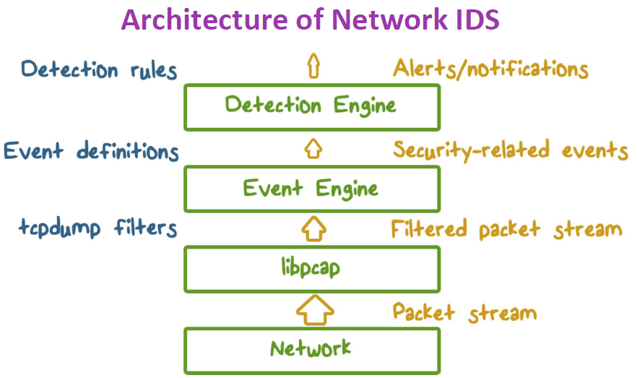
Intrusion Detection Network Based IDS (NIDS)
Packet data volume can be huge.
Applying detection algorithms at packet level may result in a low Bayesian rate.
That’s why we need to extract “events” from a large number of packets before applying detection algorithms.

Slide 8
Intrusion Detection Firewall V.S. NIDS
Firewall
Active filtering
Fail-close -> the system is set to shut down and prevent further operation when failure conditions are detected.
NIDS
Passive monitoring
Fail-open -> when failure conditions are present, the system remains open and operations continue as if the system were not in place.

Slide 9
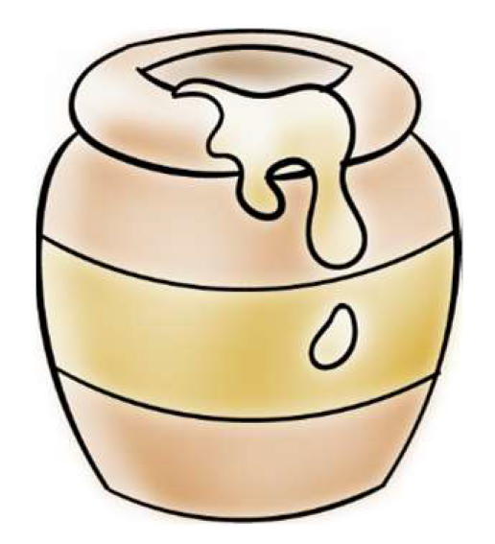
Intrusion Detection Honeypots
Decoy (引诱) systems designed to:
Lure attackers away from critical systems. (divert an attacker)
Collect information about an attacker.
Encourage an attacker to stay long enough for administrators to respond.
How does it work?
Filled with fabricated information.
Any access to a honeypot trigger monitors and event loggers.
An attack against a honeypot is made to seem successful.
There is no legitimate reason to access a honeypot. Any attempt to communicate with a honeypot is most likely a probe, scan, or attack.
If a honeypot initiates outbound traffic, the system is most likely compromised.

Slide 10
Intrusion Detection Honeypot Classification
Low interaction honeypot
Emulates particular IT services or systems well enough to provide a realistic initial interaction, but does not execute a full version of those services or systems.
Less realistic target for an attacker. But often sufficient for use as a component of a distributed IDS to warn of imminent attack.
High interaction honeypot
A real system, with a full operating system, services and applications, which are instrumented and deployed where they can be accessed by attackers.
More realistic target that may occupy an attacker for an extended period. However, it requires significantly more resources.

Slide 11
Intrusion Detection Evaluating IDS
True Positive (TP) rate (Detection rate)
Given that there is an intrusion, how likely will the IDS correct output an alert.
False Negative rate: FN = 1-TP
False Positive (FP) rate (False alarm rate)
Given that there is no intrusion, how likely is the IDS to falsely output an alert.
True Negative rate: TN = 1-FP
Bayesian detection rate
Given that the IDS produces an alert, how likely is it that an intrusion actually occurs.

Slide 12
Intrusion Detection Intrusion Prevention Systems (IPS)
Is an extension of an IDS that includes the capability to attempt to block or prevent detected malicious activity.

Slide 13
Intrusion Detection
Mathematical Attacks
A mathematical attack involves the use of computation based on the mathematical properties of the encryption algorithm to attempt to decrypt data.
Timing Attack
The attacker attempts to compromise a cryptosystem by analyzing the time taken to execute cryptographic algorithms. Every logical operation in a computer takes time to execute, and the time can differ based on the input. With precise measurements of the time for each operation, an attacker can work backwards to the input.

Slide 14
Cryptography Ciphertext-only Attack
An attack model for cryptanalysis where the attacker is assumed to have access only to a set of ciphertexts.
The attack is completely successful if the corresponding plaintexts can be deduced, or even better, the key.
While the attacker has no channel providing access to the plaintext prior to encryption, in all practical ciphertext-only attacks, the attacker still has some knowledge of the plaintext. For instance, the attacker might know the language in which the plaintext is written or the expected statistical distribution of characters in the plaintext.
Is the easiest to defend against -> confusion and diffusion

Slide 15
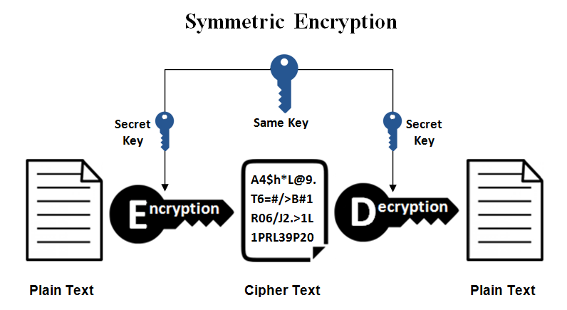
Cryptography Symmetric and Asymmetric Encryption
Symmetric:
And old and best-known technique. Involves only one secret key to cipher and decipher information.
Main disadvantage: all parties have to exchange the key used to encrypt the data before they can decrypt it.

Slide 16
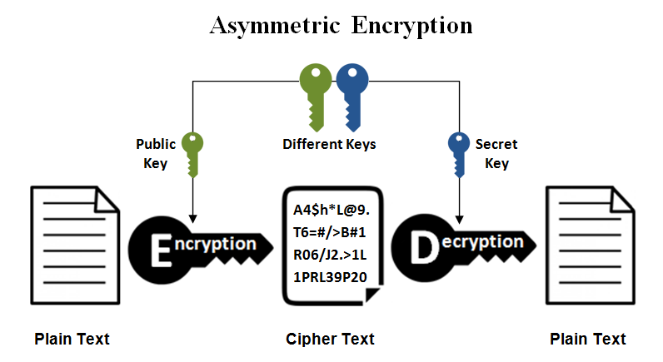
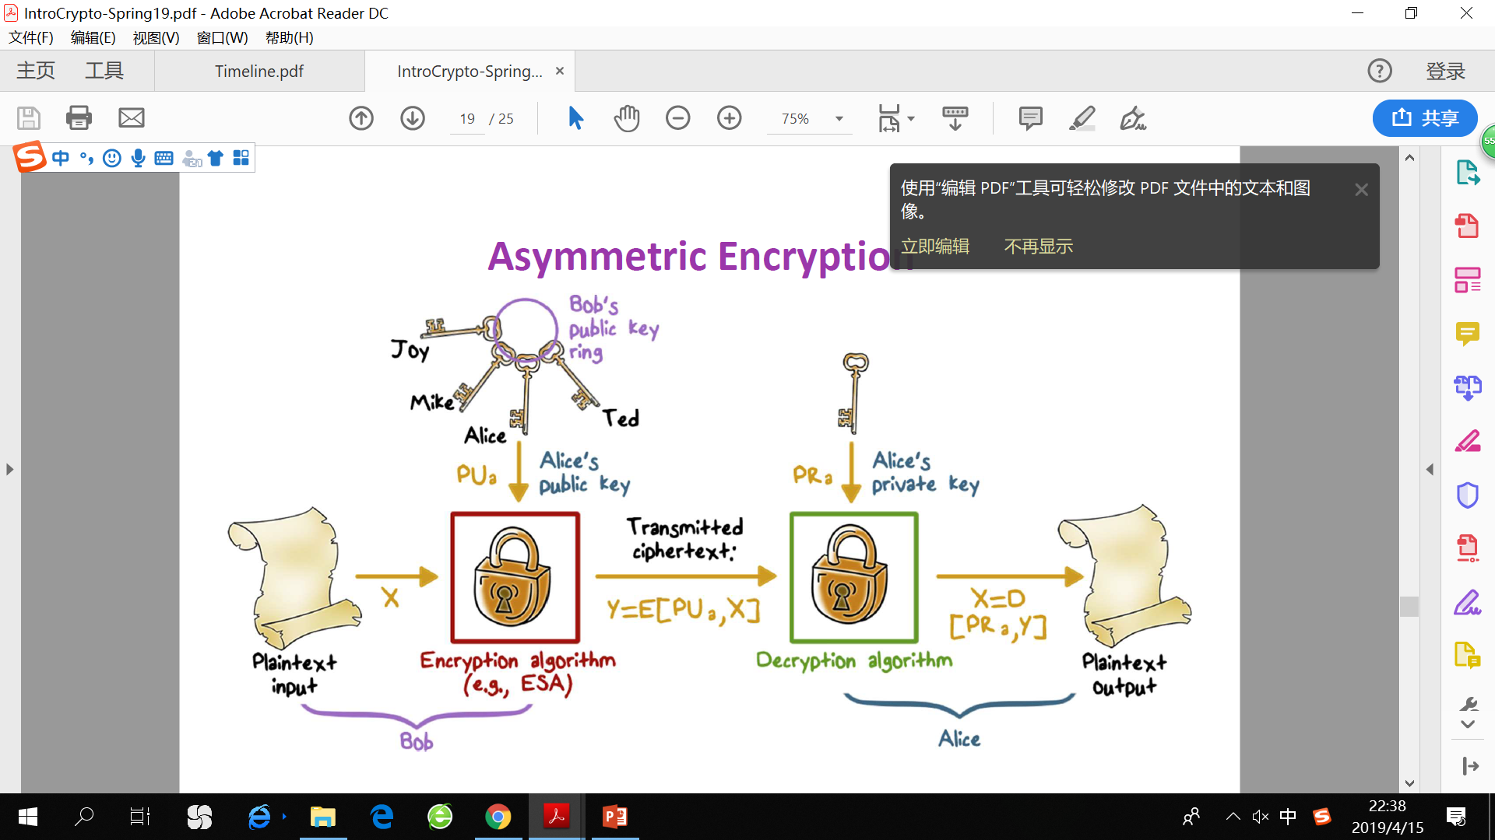
Cryptography Symmetric and Asymmetric Encryption
Asymmetric:
Also known as public key cryptography, relatively new method.
A public key is made freely available to anyone who might want to send you a message. The private key is kept a secret so that you can only know.
Public for encryption, private for decryption; Private for signing and public for verification.

Slide 17
Cryptography Symmetric and Asymmetric Encryption
Hybrid schemes – most protocols now use both asymmetric and symmetric ciphers
Asymmetric ciphers for authentication, key exchange(management) and digital signatures.
Symmetric ciphers for encryption of data/traffic
Symmetric encryption is used primarily to provide confidentiality.

Slide 18
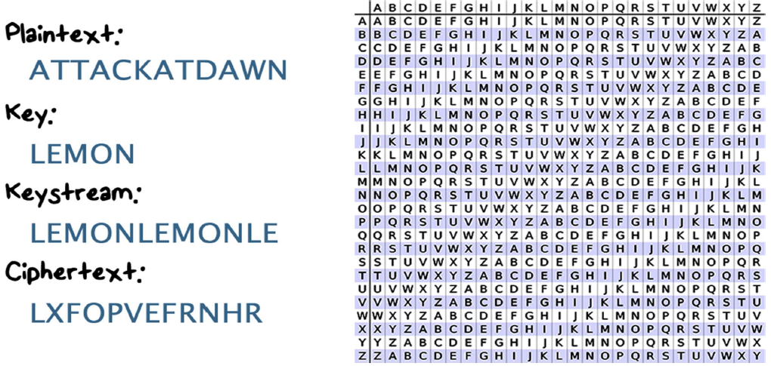
Cryptography Simple Ciphers
Caesar’s cipher (shift cipher)
Shift by an offset n
Only 26 possible ways of secret coding! Brute-force attack
Monoalphabetic cipher (substitution cipher)
Arbitrary mapping of one letter to another.
Attack with statistical analysis
of letter frequencies
Vigenere Cipher

Slide 19
Cryptography Hash functions
The purpose is to produce a “fingerprint” of a file, message, or other block of data.
One-way function: Easy to compute H(m), but given H(m), no easy way to find m
Weak collision resistant: Given m1, it’s computationally infeasible to find m1 != m2, s.t. H(m1) = H(m2)
Strong collision resistant: It’s computationally infeasible to find m1 != m2, s.t. H(m1) = H(m2)

Slide 20
Cryptography Digital Signature and Digital Envelope
Two specific applications of computer security technology that can enhance the functionality of electronic mail.
Digital envelope is the electronic equivalent of putting your message into a sealed envelope to provide privacy and resistance to tampering.
Digital signature is the electronic equivalent of sealing the message so that the receiver has a high degree of confidence that the message really came from the purported sender and that no one has altered it.
These two security functions are mutually independent. You can apply neither, either, or both to a message.

Slide 21
Cryptography Digital Signature
Alice digitally signs a file and send it to Bob
1) The hash value of the file content is calculated by Alice’s computer.
2) The hash value is encrypted with Alice’s PRIVATE key to create a digital signature.
3) The original file along with its digital signature are sent to Bob.
4) After Bob receives the signed message, the associated application identifies that the message has been signed. Bob’s computer will decrypt the digital signature using Alice’s PUBLIC key. And then calculate the hash of the original file.
5) Compare the hash computed from received file and the hash decrypted from Alice’s digital signature. Any difference would reveal tampering of the message.

Slide 22
Cryptography Digital Envelope
Allows the user to encrypt data with the speed of secret key encryption and the security of public key encryption.
Uses two layers for encryption: secret key is used for message encoding and decoding. Public key encryption is used to encrypt the secret key and send it to a receiving party.
A digital envelope can be decrypted by using the receiver’s private key to decrypt the secret key and using the secret key to decrypt the data.

Slide 23
Cryptography Stream cipher and Block cipher
Stream cipher
converts the text by taking one byte of the plain text at a time.
Relies on confusion only
Block cipher
converts the plain text by taking a block at a time
Uses both confusion and diffusion
!!! Confusion and diffusion by themselves cannot provide strong enough security. Combination of substitution and permutation, and do so often enough so that a bit change can affect every output bit.

Slide 24
Cryptography Block Cipher Primitives
Confusion
The relationship between the key and ciphertext is obscured. Ensures that if one gets the cipher text, he cannot read the real meaning.
Each bit of the ciphertext should depend on several parts of the key, obscuring the connections between the two.
If a single bit in the key is changed, most bits in the ciphertext will also be changed
Achieved with substitution (letters will not be encoded with itself!)
Diffusion
Hide the statistical properties of the plaintext. If we change a single bit of the plaintext, statistically half of the bits in the ciphertext should change.
Achieved with permutation

Slide 25
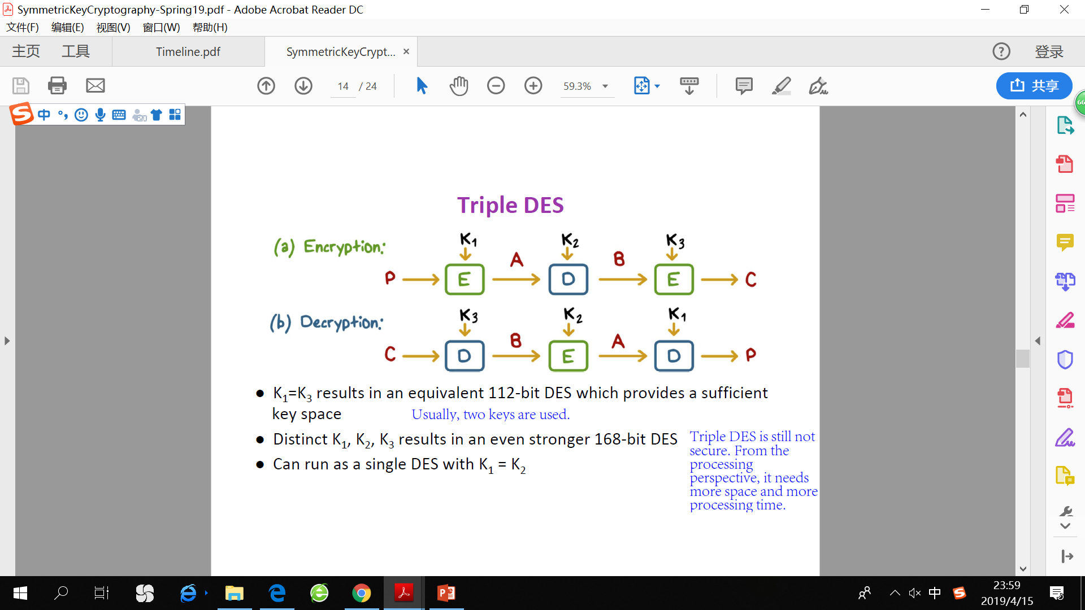
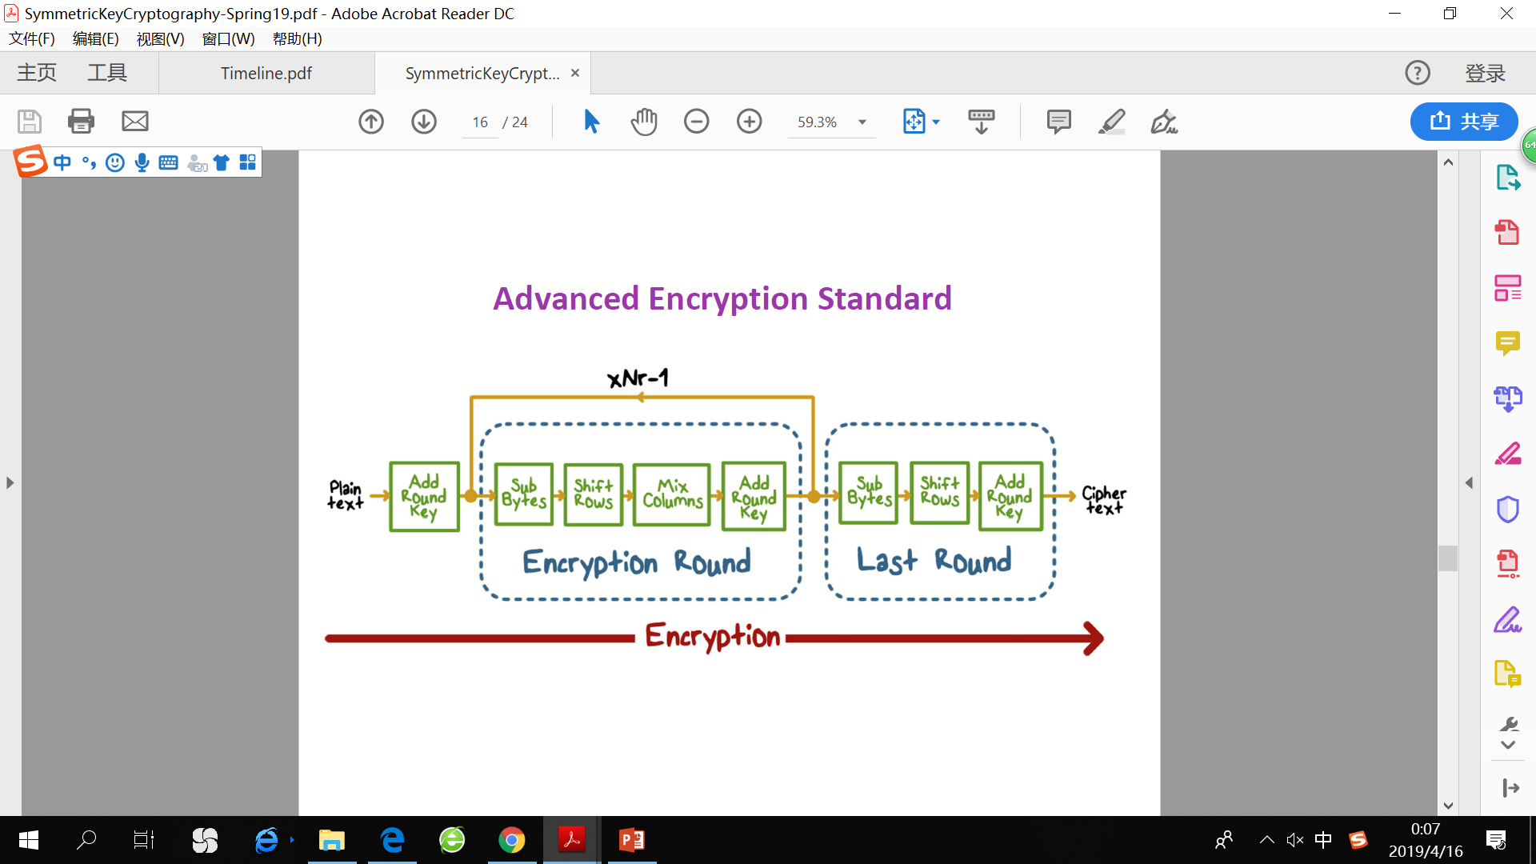
Cryptography
DES
Key space is too small (2^56 keys). Exhaustive key search relatively easy with today’s computers.
Triple DES
AES
DES and Triple-DES are based on Feistel Structure.
AES is based on substitution-permutation network instead of Feistel.

Slide 26
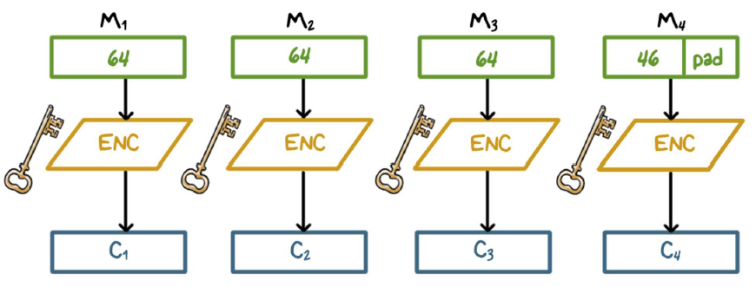
Cryptography
ECB (Encrypting Code Book)
Vulnerability 1: M1==M3 -> C1 ==C3, provides an association between same characters in the plain text.
Vulnerability 2: Lack protection against integrity attacks, such as cipher block substitution and rearrangement, fabrication of specific information.

Slide 27
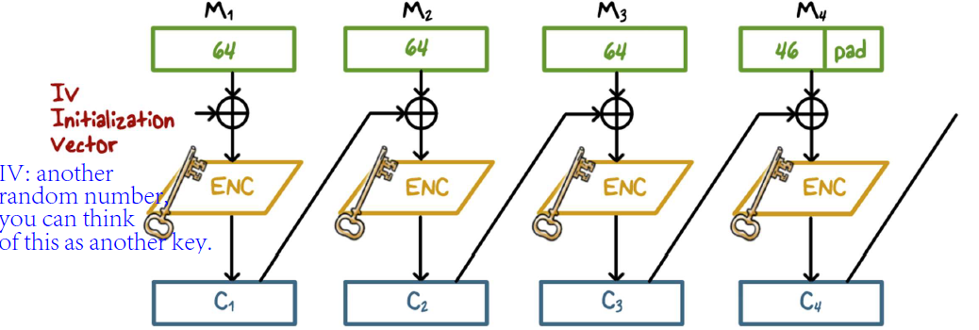
Cryptography
CBC (Cipher Block Chaining)
M1==M3 unlikely leads to C1==C3
All of the blocks are associated, you cannot take a single piece out.
Identical ciphertext can only result if the same plaintext block is encrypted using both the same key and initialization vector, and if the ciphertext block order is not changed.
It has the advantage over ECB in that the XOR process hides plaintext patterns.

Slide 28
Cryptography Protecting Message Integrity
Should use two separate secret keys: one for encryption and the other for generating residue (two encryption passes)

Slide 29
Cryptography Public Key Cryptography
Non-repudiation
Non-repudiation makes it very difficult to successfully deny who/where a message came from as well as the authenticity of that message, which provides proof of the origin of data and integrity of data.
Digital signatures can offer non-repudiation when it comes to online transactions. In this case, non-repudiation refers to the ability to ensure that a party to a contract must accept the authenticity of their signature on a document or the sending of a message.
Can only be provided by public key cryptography.
Number Theory
Multiplicative Inverse: y is the multiplicative inverse of x mod n if x*y mod n =1.
Only the numbers relatively prime to n has mod n multiplicative inverse.
Totient Function: phi(n) = number of positive integers smaller than n and relatively prime to n

Slide 30
Cryptography RSA
Support both public key encryption and digital signature
Theoretical basis: factoring a very large integer is hard.
Variable key length, variable plaintext block size. Ciphertext block size is the same as the key length
Plaintext is treated as an integer, and must be smaller than the public key n.
Key generation:
Choose two distinct prime numbers p,q
N = p*q, phi(n) = (p-1)*(q-1)
Choose e s.t. 1<e<phi(n), e is relatively prime to phi(n)
Calculate d, the multiplicative inverse of e mod phi(n)
How does RSA work?
Encryption: c = m^e mod n
Decryption: m = c^d mod n
Signature: s = m^d mod n
Verification: m = s^e mod n
Proof: m = m^(de) mod n = m^(de mod phi(n)) mod n = m mod n = m, since m<n

Slide 31
Cryptography RSA In Practice
Deterministic
For the same key, a particular plaintext is always mapped to a particular ciphertext.
Malleable
Transforming a ciphertext into another leads to predictable transformation to plaintext.
For c = m^e mod n, if attack change c to s^e * c, receiver gets s*m instead of m.
PKCS (public key cryptography standard) uses OAEP (optimal asymmetric encryption padding). Append padding as prefix to m. it ensures that when RSA encrypts the same message twice, different ciphertexts will be produced.

Slide 32
Cryptography Diffie and Hellman Key Exchange
First public key algorithm
Security relies on difficulty of computing discrete logarithms.
Shared secret key is never transmitted.
Vulnerability: Bucket Bridge Attack (Man-in-the-Middle)
C plays Bob to Alice and plays Alice to Bob

Slide 33
Cryptography Digital Signal Standard
Makes use of SHA-1 and the DSA.
A type of digital signature algorithm (DSA) that was developed by the U.S. National Security Agency (NSA) to generate digital signatures for the authentication of electronic systems.
Is designed to provide only the digital signature function, cannot be used for encryption or key exchange.

Slide 34
Cryptography Elliptic Curve Cryptography (ECC)
Relies on the assumption that while it is possible to compute a point multiplication, it is conversely almost impossible to compute the multiplicand given only the original and product points.
Key benefits
Stronger keys -> small ECC keys have the equivalent strength of larger RSA keys because of the algorithm used to generate them. For example, a 256-bit ECC key is equivalent to a 3072-bit RSA. Small keys allow encryption to stay ahead of computing power without having to simply create longer keys.
Because of the smaller key size with an ECC certificate, less data is transmitted from the server to the client during the SSL handshake. ECC certificates also requires less CPU and memory, increasing network performance and making a potentially large difference on high-volume or high-traffic sites.

Slide 35
Security Protocol
Purposes
Mutually authenticate
Establish and exchange keys
Agree to cryptographic operations and algorithms

Slide 36
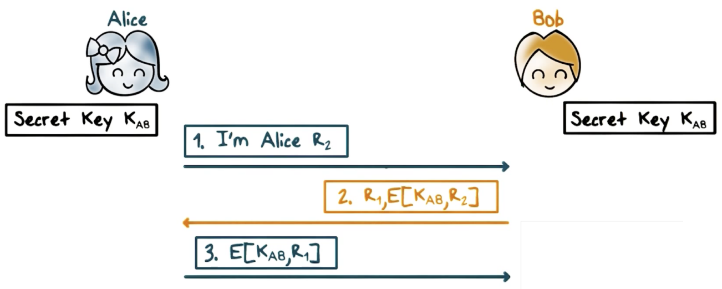
Security Protocol Mutual Authentication – shared secret

Slide 37
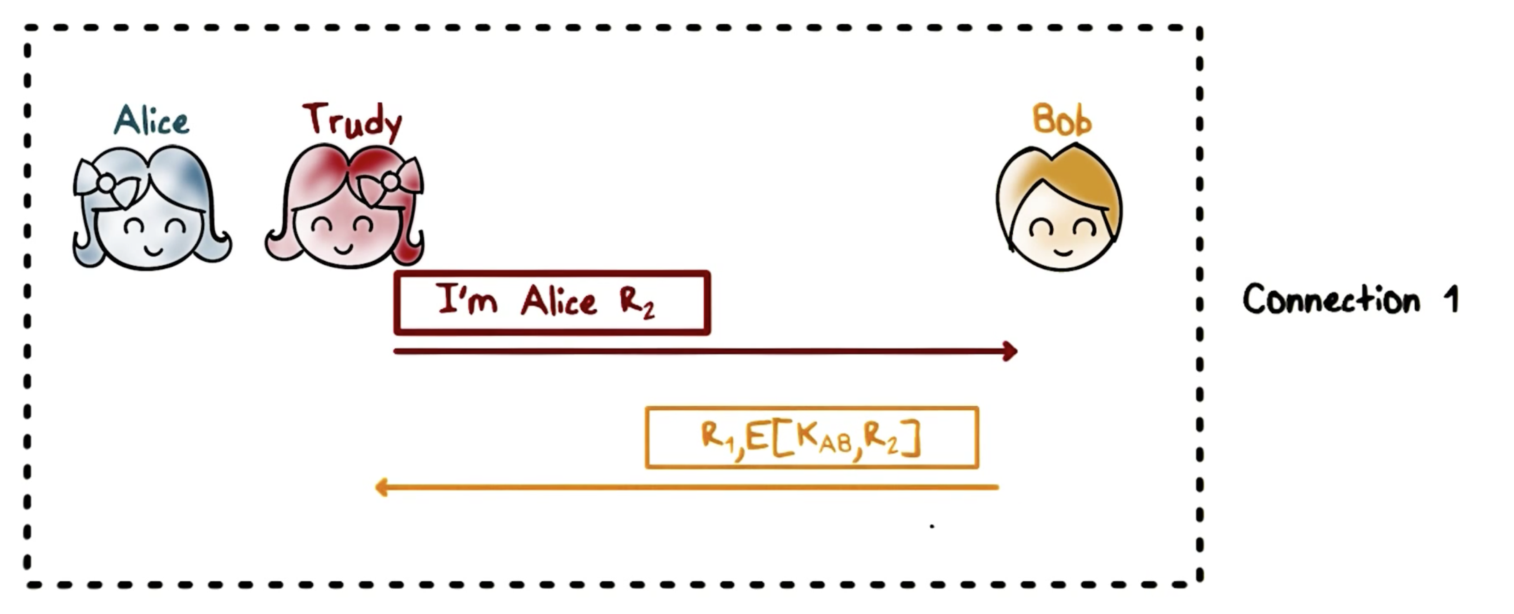
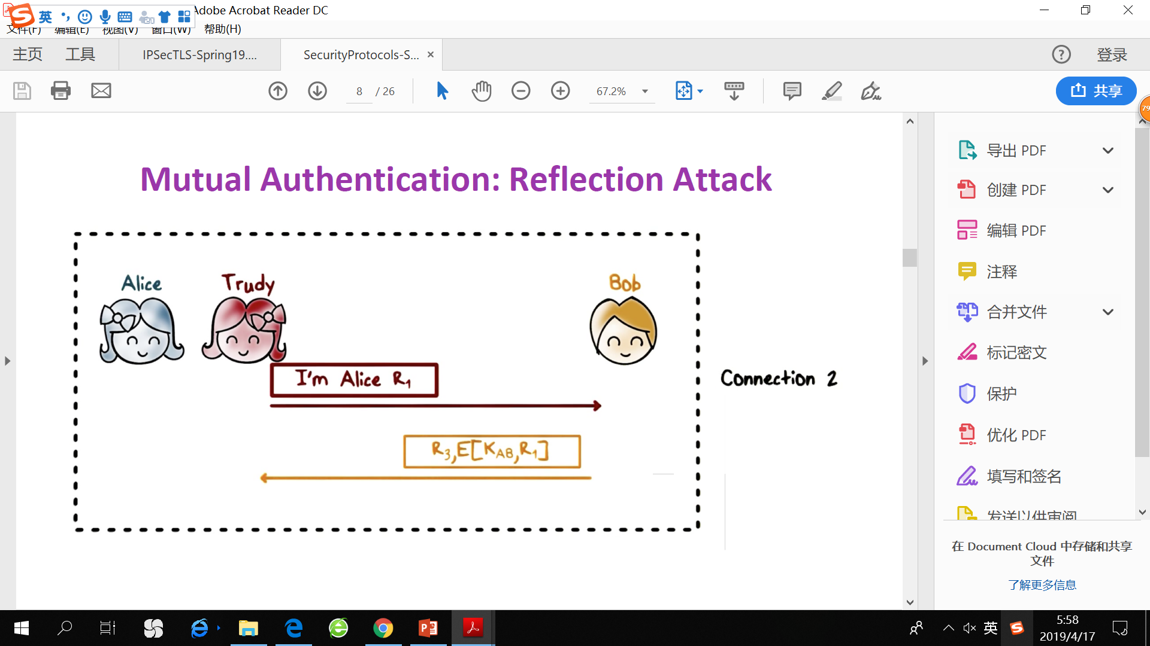
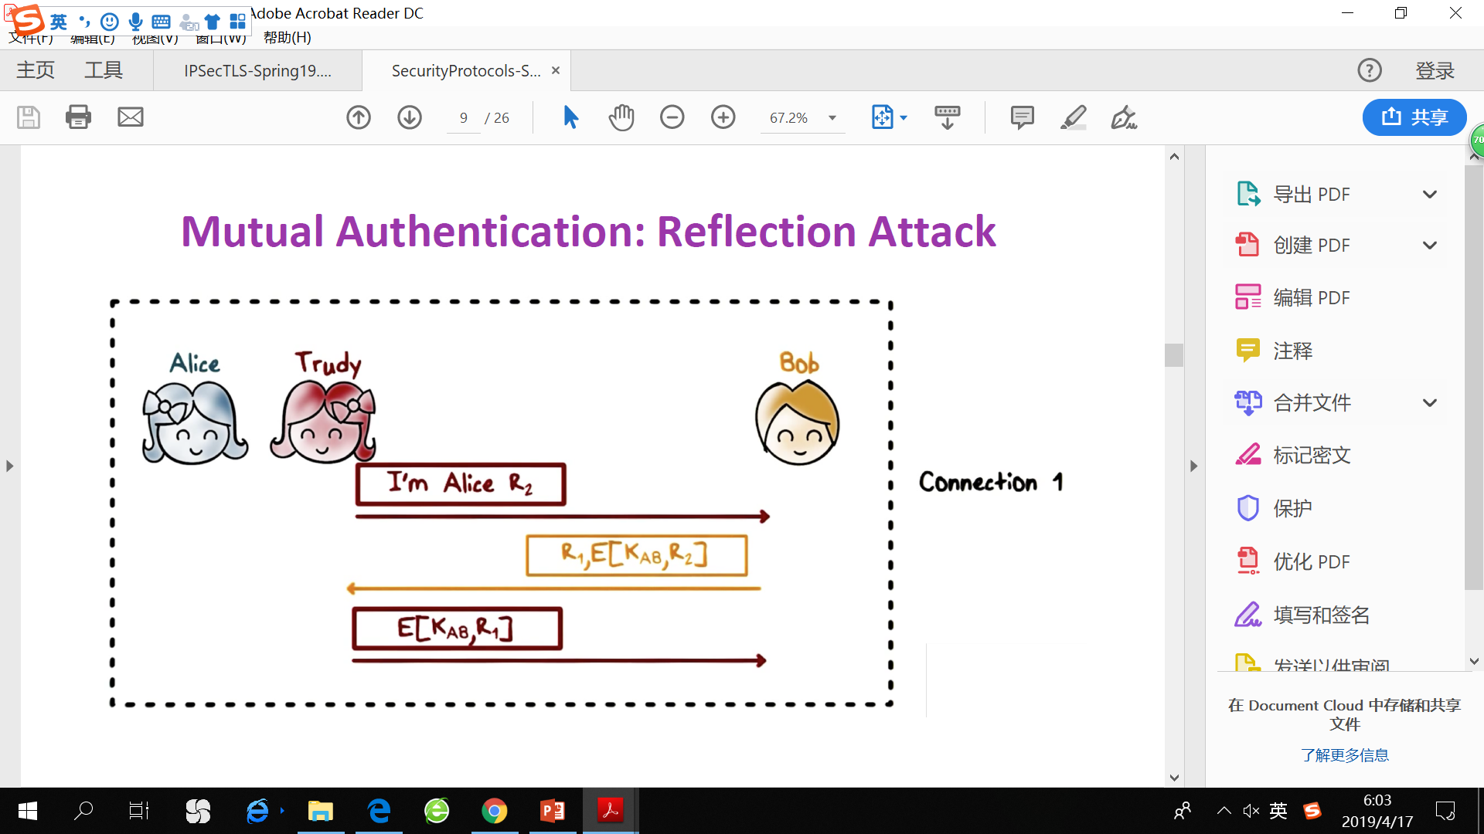
Security Protocol Mutual Authentication – reflection attack
Reflection attack exploits a common security technique known as a challenge-response authentication. The hacker logs on and receives a challenge. The server expects an answer in the form of the correct response to the challenge. The hacker then creates another connection and sends the challenge back to the server. In a weak protocol, the server will send back the answer, allowing the hacker to send the answer back through the first connection to access the server.

Slide 38
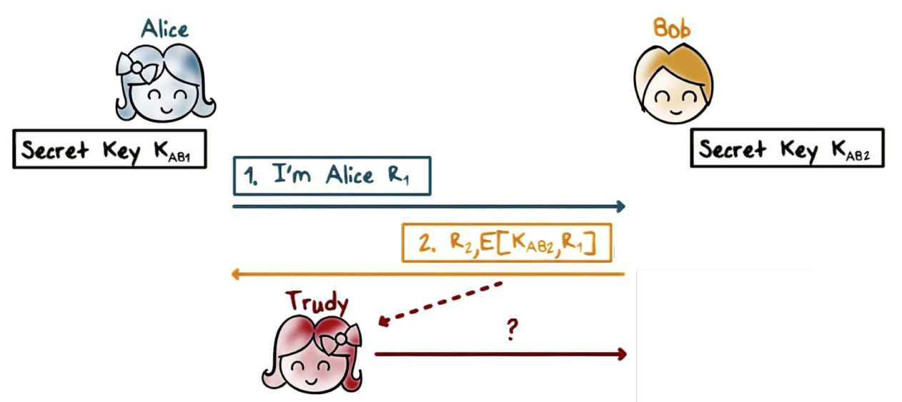
Security Protocol Mutual Authentication – reflection attack
Fixes
Use two different keys for initiator and responder.
Initiator and responder send different types of challenges. E.g. even number for initiator and odd number for responder.

Slide 39
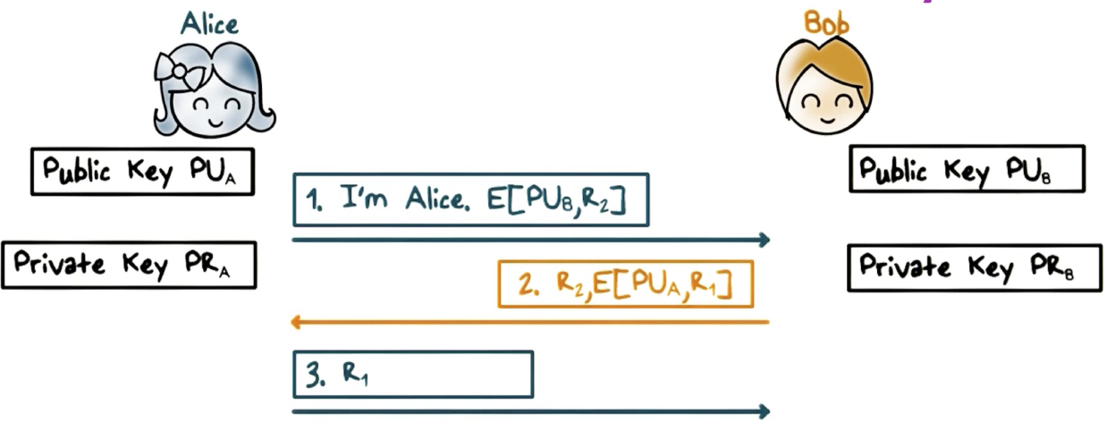
Security Protocol Mutual Authentication – public keys

Slide 40
Security Protocol Session Keys
Typically a long term secret key is called a Master key, possibly derived from a password.
The master key is used to authenticate and establish a new session key.
How to share session key?
Public key: Alice -> Bob E( PRa, E(PUb, K) ) Bob先用PUa解开(他就能保证这条信息是Alice发来的，integrity)，之后Bob用PUb解(only Bob can decrypt, ensures confidentiality)。
Diffie-Hellman

Slide 41
Security Protocol Kerberos
A network authentication and access control protocol. It is designed to provide strong authentication for client/server applications by using secret-key cryptography.
Support both inter-realm and cross-realm authentication. If realm A trusts realm B, then clients in realm A can have chance to communicate with the TGS in realm B, and thus, communicate with servers in realm B.
Why Kerberos?
考虑这样一个场景，在一个网络中有不同的服务器，比如打印机，邮件服务器等。这些服务器都有认证的需求。但不可能让每个服务器自己实现一套认证系统，而是提供一个中心认证服务器(AS - Authentication Server)。这样任何客户端(client)只需维护一个密码就能登录所有服务器。
因此，在Kerberos中至少有三个角色：认证服务器 AS, 客户端 client，普通服务器 Server。同时，client和server都有密码，它们的密码只有自己和AS知道。
Client和Server都有唯一的名字，叫做principal。

Slide 42
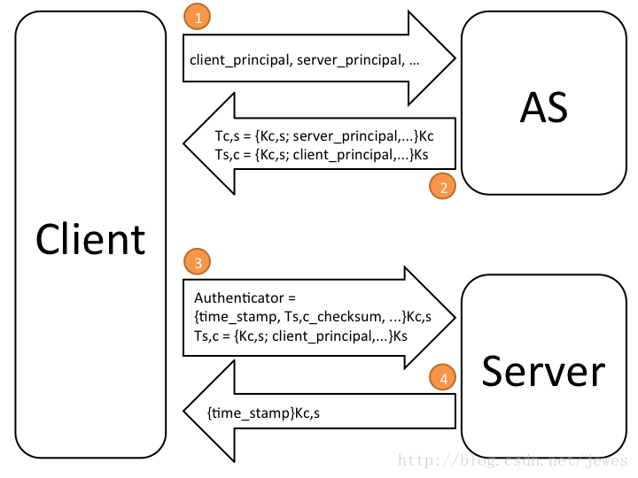
Security Protocol Kerberos – 简化认证流程
1. client向AS发起请求，内容是：我是谁(client’s principal), 我要和谁通信(server’s principal).
2. AS收到请求后随机生成一个session key (Kc,s), 并且生成两个ticket，分别用client和server自己的密码加密。Client不能篡改给server的那张ticket (Ts,c)因为是用server自己的密码加密的。
3. client用自己的密码解开自己的ticket (Tc,s), 然后生成一个认证(authenticator), 里面含有当前时间戳和Ts,c的校验码，并用session key (Kc,s)加密。将authenticator和server的ticket (Ts,c)同时发给server。

Slide 43
Security Protocol Kerberos – 简化认证流程
4. server首先用自己的密码解开自己的ticket (Ts,c), 拿到session key (Kc,s), 然后用Kc,s解开authenticator，并做如下检查：
时间戳是不是当前时间上下5分钟内，并且检查该时间戳是否首次出现。若不是首次出现，说明有人截获了之前client发送的内容，进行replay攻击。
检查check_sum是否正确。
若都正确，则通过认证。Server可选择性地回复一条消息来双向认证。Client可用Kc,s解开server返回的时间戳，比较是否与自己发的那个一致，来验证server。
Client与server完成双向认证后，它们就可以通过session key来传输内容。

Slide 44
Security Protocol Kerberos – 完整认证流程
在简化认证流程中，比较不方便的是每次认证都需要客户端输入自己的密码。我们希望AS能给client一个“联票”，第一次获取联票的时候比较麻烦，之后每次client与server通信只需出示联票即可，无需每次都输入密码，减少了暴露密码的机会。
在Kerberos中引入一个新的角色：TGS – Ticket Granting Service，它类似一个普通的服务器，它提供的服务是为客户端发放用于和其他server通信的联票。
KDC (key distribution center) – 提供AS和TGS两种服务。

Slide 45
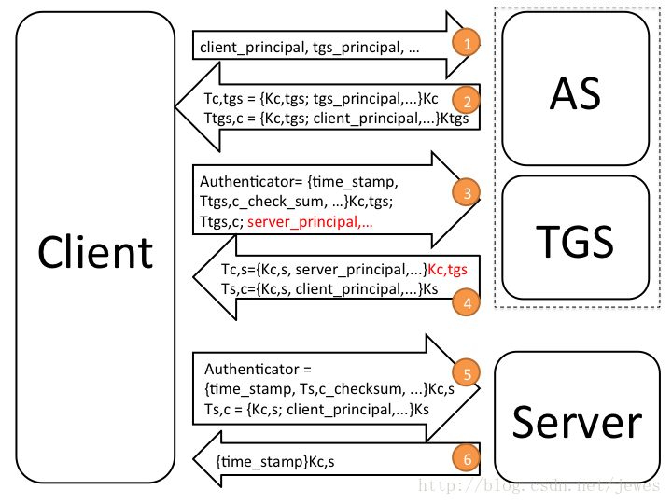
Security Protocol Kerberos – 完整认证流程
1-2. 第一次获取联票时先跟AS请求跟TGS通信。AS会生成client与TGS的session key (Kc,tgs)。
3-6. 此后TGS就充当了AS的位置，每次client拿着“联票”(Kc,tgs)给TGS发送与某个server通信的请求，TGS会生成client与server的session key (Kc,s)。每次通信只需要执行step3-6。

Slide 46
Security Protocols Kerberos Benefits
Localhost does not need to store passwords.
The master key that the user shares with KDC is only used once every day (has expiration deadline) -> limits the exposure of the master key!

Slide 47
IPSec Vulnerability – IP spoofing
Bots spoof an IP address of a victim website.
Then send DNS queries to DNS servers.
The DNS servers respond, sending large amounts of data to the victim.
Result: a denial-of-service attack.

Slide 48
IPSec Vulnerability - Replay Attack
What is replay attack?
In a replay attack, a hacker uses a protocol analyzer to monitor and copy packets as they flow across the network. Once the hacker has captured the necessary packets, he can filter them and extract the packets that contain things like digital signatures and various authentication codes. After these packets have been extracted, they can be put back on the network (or replayed), thus giving the hacker access to the desired access.
Defend: Timestamp or sequence number
When a packet is sent to a recipient, the recipient extracts the sequence number and records the sequence number in a table. Now, suppose a hacker captured and replayed a packet. The recipient would extract the sequence number and compare it against the table that it has been recording. But the packet's sequence number will already exist in the table, so the packet is assumed to be fraudulent and is therefore discarded.

Slide 49
IPSec Benefits
It is below the transport layer and transparent to applications
Verify sources of IP packets -> defend against IP spoofing
Protect integrity and/or confidentiality of packets. The signatures added to each packet by IPSec means that you can't alter any part of a packet undetected -> defend against tampering
Prevent replaying of old packets
Provide security automatically for upper layer protocols and applications

Slide 50
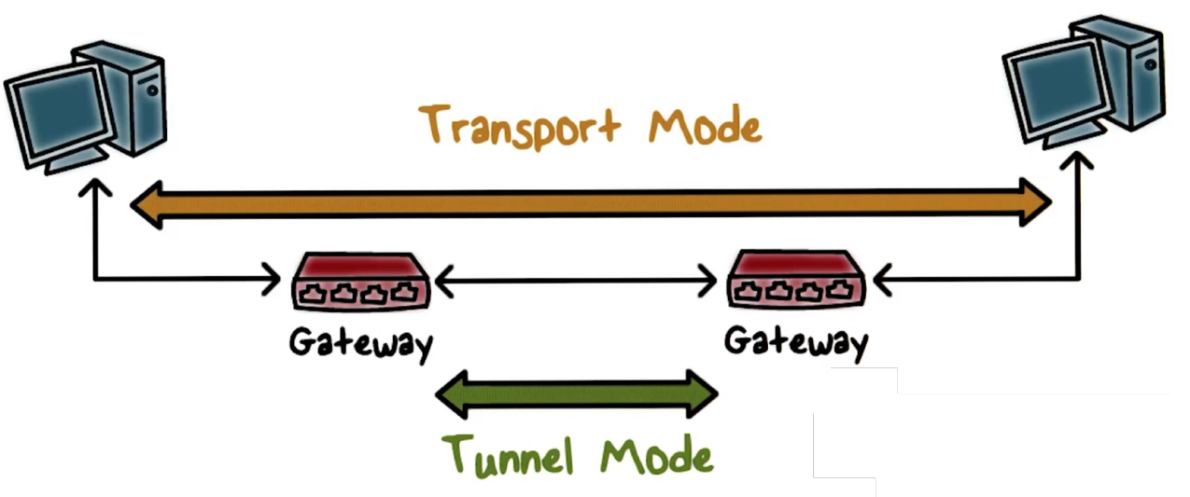
IPSec
IPSec Architecture
ESP – Encapsulating Security Payload
AH – Authentication Header (Both ESP and AH can be applied to a packet. If so, AH follows ESP.)
IKE - Internet Key Exchange
IPSec Modes
Transport mode
Tunnel mode

Slide 51
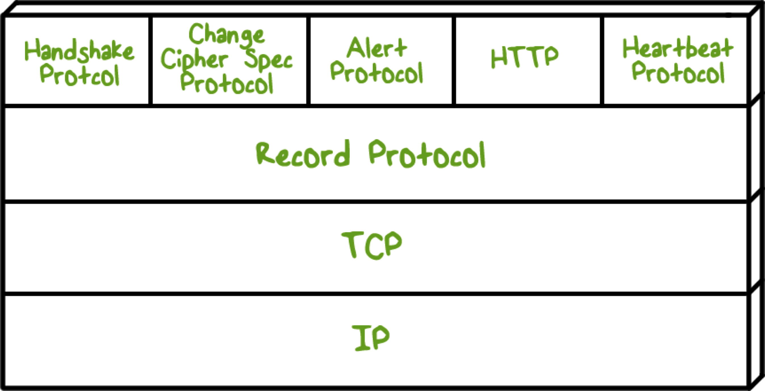
IPSec Secure Socket Layer (SSL) & Transport Layer Security (TLS)
SSL, 由NetScape设计。为啥发明这个？因为原先互联网上使用的HTTP协议是明文的，传输内容有被偷窥和篡改的风险。SSL负责提供加密的数据传输通道。TLS是SSL标准化之后的产物，这两者可以视作同一东西的不同阶段。
One of the most widely used security services
位于TCP/IP层之上，应用层之下
Two layers
Record layer
Handshake layer
Two implementation choices
Provided as part of the underlying protocol suite
Embedded in specific packages

Slide 52
IPSec TLS Handshake Protocol
Parameters
Version: the highest TLS version understood by the client
Random: a 32-bit timestamp and 28 bytes generated by a secure random number generator (client或server生成的不可预测的随机数，在后续步骤中会用到)
Session ID: a variable-length session identifier (当client和server希望使用之前建立的回话时所使用的信息)
CipherSuite: a list containing the combinations of cryptographic algorithms supported by the client
Compression Method: a list of compression methods supported by the client

Slide 53
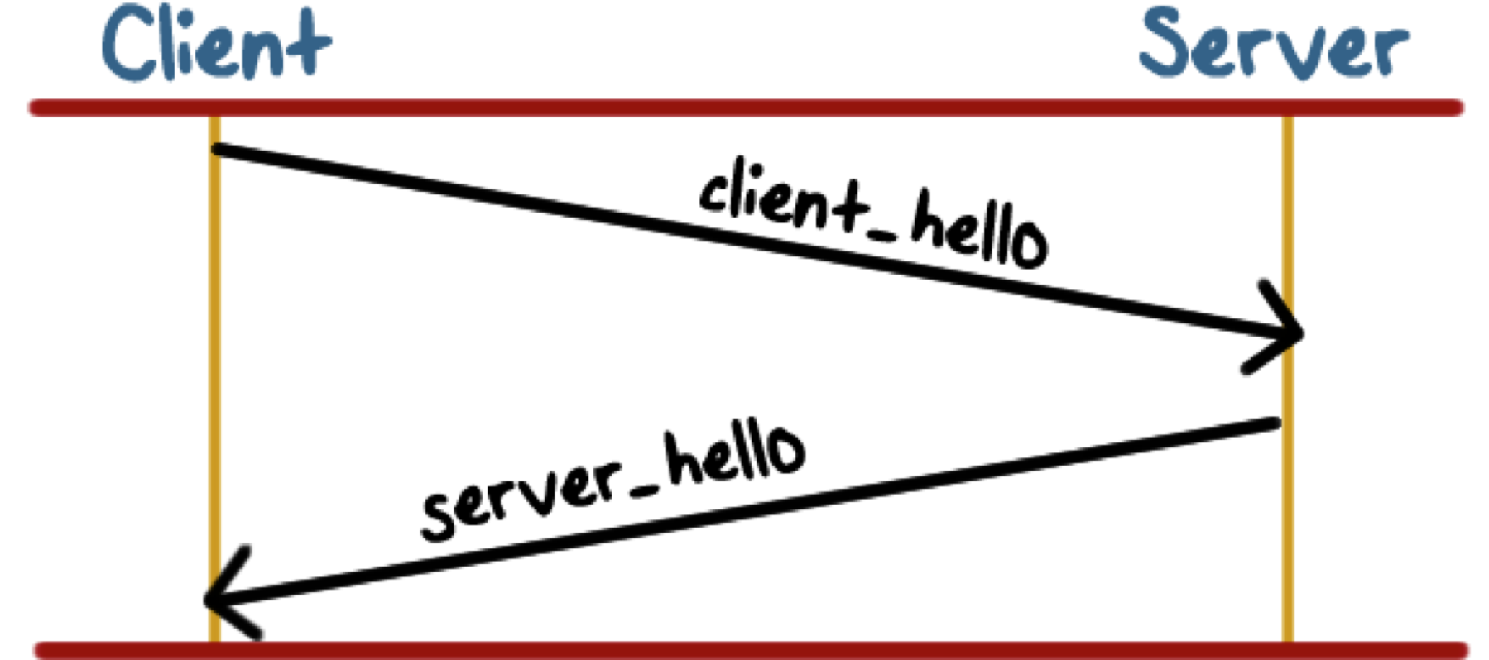
IPSec TLS Handshake Protocol
Phase 1: establish security capabilities
Client->server (TLS version, current time, client random, session ID, CipherSuite, Compression method).
Server->client (selected TLS version, current time, server random, session ID, selected CipherSuite, selected Compression method),
Phase 2
Server sends certificate
Server key exchange
Server certificate request – 为了进行客户端认证。当不使用客户端认证时，不会发送certificate request.
Server hello done

Slide 54
IPSec TLS Handshake Protocol
Phase 3
Client sends certificate
Client key exchange
Certificate verify – 只有server发送certificate request的时候才会回复certificate verify，这个目的是向服务器证明自己确实持有客户端证书私钥
Phase 4: change cipher suite
Change cipher – client和server互相告知以后都是用协商好的密钥和算法进行加密通信
Finished

Slide 55

Web security Cookies
简而言之就是浏览器暂存在你计算机上的一小笔资料，好让服务器来辨认你的计算机。
浏览器端会储存你在这个站点的一些信息，比如登录状态，用户ID，密码、浏览过的网页、停留的时间等信息，记录在cookie里，方便下次访问时发送给服务器端。

Slide 56
Web security Cross-site Script (XSS)
原理：向有漏洞的网站中输入恶意html代码。其他用户浏览该网站时，恶意代码就会自动执行。理论上，所有可输入的地方，若没有对输入数据进行处理，都会存在XSS vulnerability。
攻击目的：盗取用户cookie (document.cookie)，破坏页面结构，重定向到其他网站等。
如何寻找XSS漏洞：典型测试代码
<a href=javascript:alert(1)>hello</a> <script>alert(1)</script>

Slide 57
Web security Cross-site Request Forgery (XSRF) 攻击过程
User visit trusted website A, login by username and password.
Before user log out from A, in the same browser, he visits an evil website B.
B has some malicious code that sends request to visit A.
When the browser executes the malicious code, it send request to A with user’s cookie without user’s awareness.
A regards it as a normal request initiated by the user, so it will deal with it under the rights of user.

Slide 58
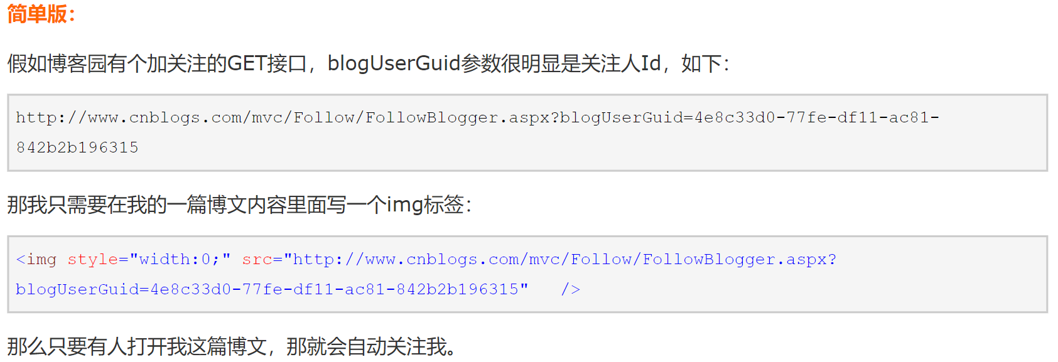
Web security Cross-site Request Forgery (XSRF)
GET请求的参数放在URL里，POST请求参数放在请求body里。这就是为何应尽量使用POST而限制GET。GET接口太容易被拿来做XSRF，只要构造一个img标签，而img标签又是不能过滤的数据。
当然POST也不是万无一失，需要构造一个form，但这需要在第三方页面做，增加了暴露的可能性。

Slide 59
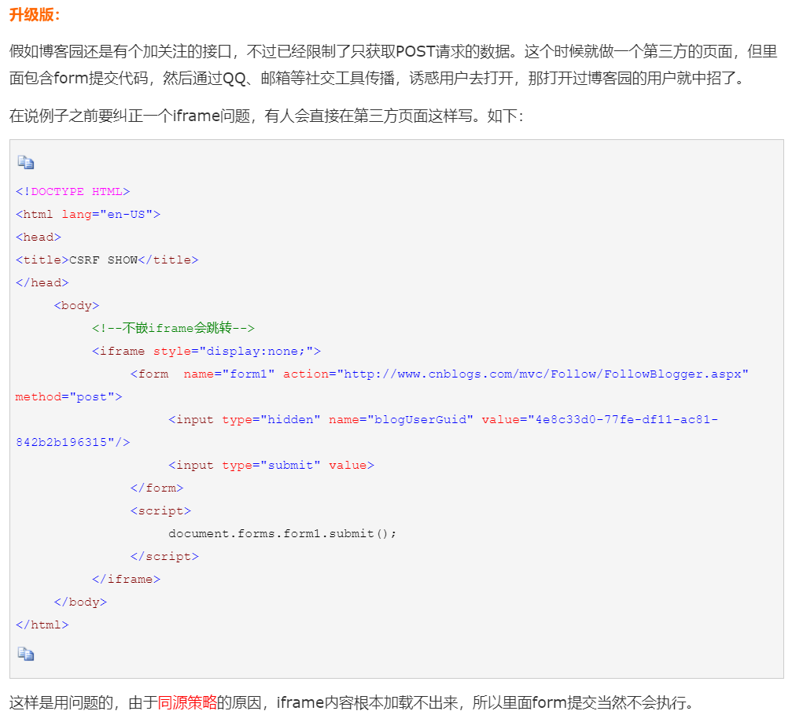
同源策略：同源是指同协议、同域名、同端口。要求动态内容（如JavaScript，VBScript）不能读取来自不同源的内容。但同源策略也给XSRF创造了机会。因为它仅仅阻止了脚本读取来自其他站点的内容，却没有防止脚本向其他站点发出请求。所以同源策略无法防止XSRF攻击！

Slide 60
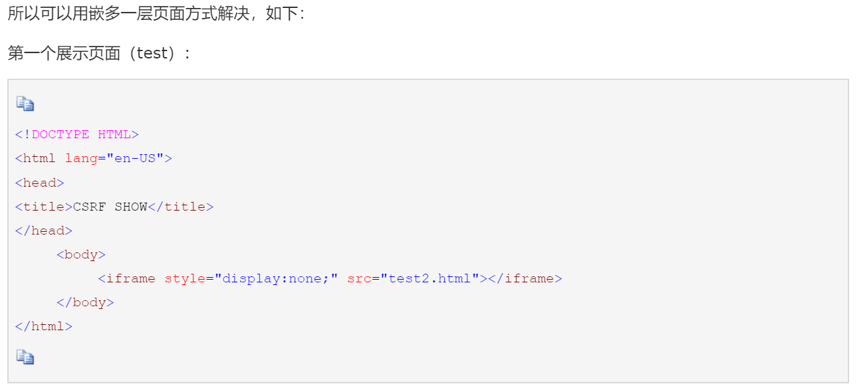
Web security Cross-site Request Forgery (XSRF)

Slide 61
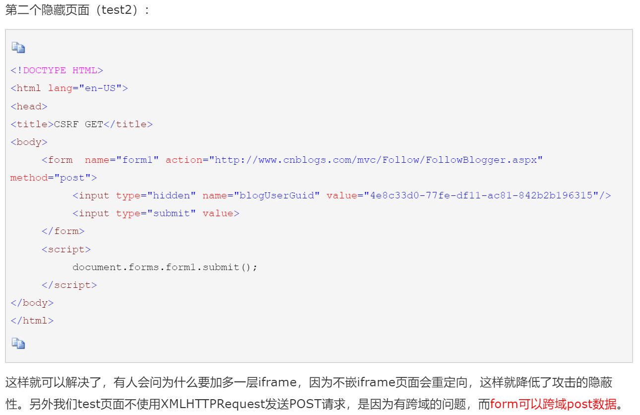
Web security Cross-site Request Forgery (XSRF)

Slide 62
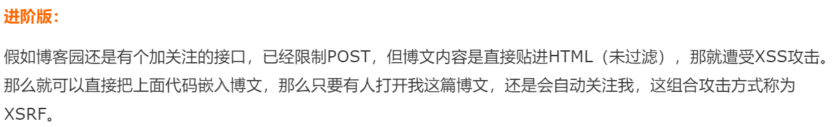
Web security Cross-site Request Forgery (XSRF)

Slide 63
Web security XSS v.s XSRF
XSS
User trusts a badly implemented website.
Attacker injects a script into the website.
User’s browser executes the script whenever user opens the website.
XSRF
A badly implemented website trusts the user.
Attacker tricks user’s browser into issuing requests to the website.
The website regards the request as one from the user and executes attacker’s request

Slide 64
Web security SQL Injection
Using an input filter to block certain characters is an effective way to prevent SQL injection attacks, BUT it cannot fix the vulnerability!
An attacker does not always need quote and semi-colon to run a separate SQL statement.

Slide 65
Laws; Ethics; Privacy Computer Abuse Laws Enforcement Challenges
Enforcement is difficult because attribution is hard (evidence collection, forensics (取证), etc.)
Transnational nature of the Internet.
Cyber criminal ecosystem evolves to undermine legal safeguards (The relative lack of success in bringing cybercriminals to justice has led to an increase in their numbers, boldness, and the global scale of their operations).

Slide 66
Laws; Ethics; Privacy Privacy Challenges
Privacy is now a new problem
People have always worried about what others (friends, enemies, governments) might know about what they do.
Concerns: Scale and magnitude at which information about us can be collected, ways in which it can be used, and shared or sold.
Need privacy not only for individuals, but also for universities, hospitals, charities, since they need to protect data of people they serve or have as employees.

Slide 67
Laws; Ethics; Privacy Privacy Challenges
Hard to distinguish between legitimate use and non-legitimate ones.
Tracking of people’s activities does not mean that they are interested in what “you” as an individual are doing. Most of the time, people are learning about customer behavior to improve user experience, or serve user targeted advertisements.
Sometimes we are willing parties to provide our information for the experts to analyze. BUT how can we guarantee the data is only used for specified purpose we agreed to?

Slide 68
Laws; Ethics; Privacy Good Privacy Policy needs to concern:
What information is collected about you?
How is the collected information used?
Who do they share it with?
Cooperators
Domain administrators and resellers
Affiliates and other trusted businesses (with appropriate confidentiality and security measures)
For legal reasons
Information security
Use encryption
Two-factor authentication
Adhere and operate according to the privacy policy you gave consent to.
Changes to privacy policy – will not reduce user rights without your consent.

Slide 69

Laws; Ethics; Privacy Privacy Enhancing Technologies - Tor
洋葱路由引入的是P2P的分布式机制，将每一个安装了Tor的计算机变成加密的中继连接，当有人访问暗网时，他的路径会无序化地经过多个中继连接，而且每一次路径都是变化的，没有任何一个中继或服务器能够捕捉完整的连接痕迹。
如A传给B信息，要先后随机经过C、D、E等一众人，且彼此都是匿名加密的，无法被追踪。
目标 – Go against network traffic analysis

